Slide 1
SQL: STRUCTURED QUERY LANGUAGE

Slide 2
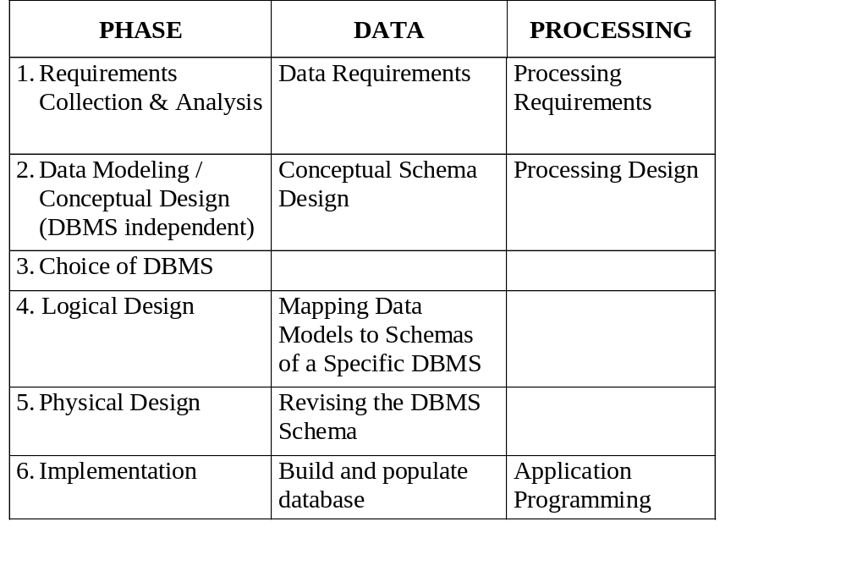
PHASES OF THE
DATABASE DESIGN PROCESS

Slide 3
Outline
Data Definition
  Create/Drop/Alter table
Data Manipulation
  Insert/delete/update tuples
  SQL query basics
  Advanced queries
More on Data Definition

Slide 4
Create Table
create table TABLENAME
(COLNAME COLTYPE [default VALUE] [ATTRIBUTE-CONSTRAINT],
...,
TABLE-CONSTRAINT-LIST, ...);
where
ATTRIBUTE-CONSTRAINT represents constraints on the attribute, and
TABLE-CONSTRAINT-LIST represents constraints on the table

Slide 5
Data Types in SQL
Characters:
  CHAR(20) -- fixed length
  VARCHAR(40) -- variable length
Numbers:
  BIGINT, INT, SMALLINT, TINYINT
  REAL, FLOAT -- differ in precision
Times and dates:
  DATE
  DATETIME -- SQL Server
Others... All are simple

Slide 6
Create Table: Attribute Constraints
ATTRIBUTE-CONSTRAINT ::= [constraint CONSTRAINT-NAME]
not null | primary key | unique |
CHECK-CONSTRAINT | COLUMN-REFERENCE
CHECK-CONSTRAINT ::= check (BOOLEAN-VALUED-EXPRESSION)
COLUMN-REFERENCE ::= references REFERENCED-TABLE-NAME
[(REFERENCED-COLUMN-NAME)]
[on update ACTION] [on delete ACTION]
ACTION ::= no action | cascade | set null | set default /*for maintaining referential integrity*/
  No action: Reject violating modifications (default)
  Cascade: after a delete/update on the referenced tuple, do a delete/update on the referencing tuples
    In general, cascade option is suitable for referencing relations that presents relationships, multi-valued attributes, and week entity types.
  Set-null/default:
    set foreign-key field to NULL/default value

Slide 7
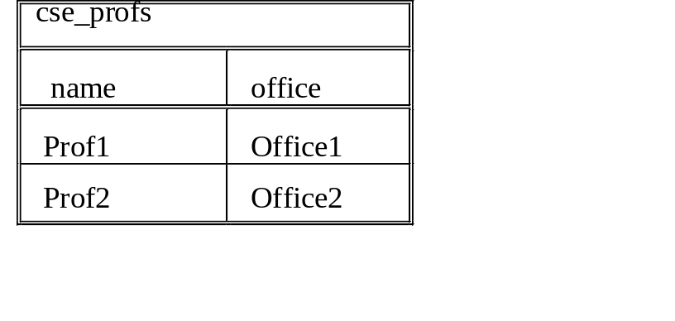
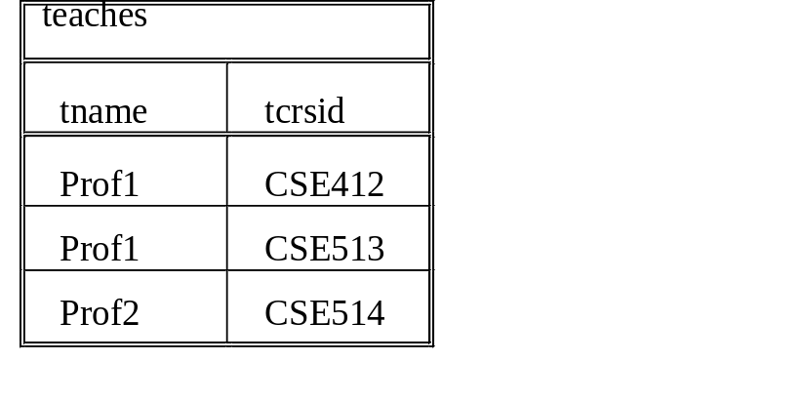
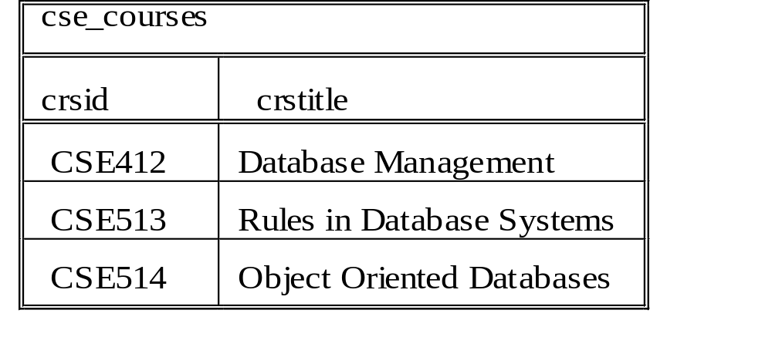
Example (I)
create table teaches
(tname varchar(24), references cse_profs(name) on update cascade,
tcrsid varchar(6), references cse_courses(crsid)
on update cascade
);
Note: this command only creates the schema, but does not insert data instances.

Slide 8
Create Table: Table Constraints
TABLE-CONSTRAINT-LIST ::= [constraint CONSTRAINT_NAME]
PRIMARY-KEY-CONSTRAINT | UNIQUE-CONSTRAINT |
REFERENTIAL-CONSTRAINT | CHECK-CONSTRAINT
PRIMARY-KEY-CONSTRAINT ::= primary key (COLUMN-NAME {,COLUMN-NAME })
UNIQUE-CONSTRAINT ::= unique (COLUMN-NAME {,COLUMN-NAME})
REFERENTIAL-CONSTRAINT ::= foreign key (REFERENCING-COLUMN-NAME
{, REFERENCING-COLUMN-NAME }) REFERENCES-SPECIFICATION
REFERENCES-SPECIFICATION ::= references REFERENCED-TABLE-NAME
[(REFERENCED-COLUMN-NAME {, REFERENCED-COLUMN-NAME })]
[on update ACTION] [on delete ACTION]
ACTION ::= no action | cascade | set null | set default

Slide 9
Example (II)
create table teaches
(tname varchar(24),
tcrsid varchar(6),
primary key (tname, tcrsid),
foreign key (tname) references cse_profs(name)
on update cascade,
foreign key (tcrsid) references cse_courses(crsid)
on update cascade);
Note: this command only creates the schema, but does not insert data instances.

Slide 10
About IDs
When we design ER diagrams and map from ER to Relational model, we specify semantic keys for entity, in order capture the constraints in real world
When we implement a database with a specific DBMS, it is often good to generate IDs as primary keys
  Key attributes are often recorded multiple times as foreign keys; and “joins” between keys and foreign keys are common
  Using IDs can save space and achieve operation efficiency
  The semantic keys then can be modeled as candidate keys, using “UNIQUE” constraints

Slide 11
SCHEMA MODIFICATION
Drop and Alter Table
Delete a table
drop table TABLENAME
Adding an attribute to an existing relation allowing null values or default values
alter table TABLENAME
add COLNAME COLTYPE

Slide 12
Outline
Data Definition
  Create/Drop/Alter table
Data Manipulation
  Insert/delete/update tuples
  SQL query basics
  Advanced queries
More on Data Definition

Slide 13
Insert
The insert into statement provides a mechanism to insert tuples into the named table according to the specified ATTRIBUTE-LIST and SOURCE:
insert into TABLENAME [ (ATTRIBUTE-LIST) ]
SOURCE
where SOURCE is either
  a list of explicit values
e.g. insert into cse_courses (crsid, crstittle)
values (‘CSE412’, `Database Management’)
    Missing attributes in ATTRIBUTE-LIST will have NULL values;
    May drop attribute names if they are given in order sequentially
  Or, the specification of a select statement
e.g. insert into cse_courses
select … from … where … /* to be discussed*/

Slide 14
Delete
The delete statement removes tuples from the table specified. The optional where clause restricts the delete operation to the rows of the table that satisfy the DELETE-CONDITION. If the where clause is not specified, then all rows of the table are deleted:
delete from TABLENAME
[where DELETE-CONDITION]
e.g. delete from cse_majors
where class = ‘SR’

Slide 15
Update
The update statement modifies the columns given in the set clause to the values determined by the expressions specified. The optional where clause can restrict the rows of the table to be updated:
update TABLENAME
set COLUMN-NAME = VALUE-EXPRESSION, …
[where UPDATE-CONDITION]
e.g. update cse_majors
set class = ‘SR’
where class = ‘JR’

Slide 16
Outline
Data Definition
  Create/Drop/Alter table
Data Manipulation
  Insert/delete/update tuples
  SQL query basics
  Advanced queries
Integrity Constraints

Slide 17
SQL Overview
SQL is the recognized industry-standard query language.
The original SQL standard was established in 1986 (and extended in 1989 with integrity enforcement).
The standard was updated in 1992, called SQL2, to include joined tables and data definition.
  SQL2 allows for a (natural) join specification in the from clause:
select *
from (cse_profs join teaches on name=tname)
Other releases of SQL Standard:
  SQL:1999 – Object-relational features
  SQL:2003 – XML features

Slide 18
Basic Query Expressions
A typical SQL query
SELECT A₁, A₂,..., A_{n}
FROM R₁, R₂, ..., R_{m}
WHERE P

Slide 19
Semantics of SQL Queries (I)
SELECT a1, a2, …, ak
FROM R1, R2, …, Rn
WHERE P
1. Nested loops:
Answer = {}
for x1 in R1 do
for x2 in R2 do
…..
for xn in Rn do
if P
then Answer = Answer ∪ {(a1,…,ak)}
return Answer

Slide 20
Semantics of SQL Queries (II)
SELECT a1, a2, …, ak
FROM R1, R2, …, Rn
WHERE P
2. Parallel assignment
Doesn’t impose any order !
Answer = {}
for all assignments x1 in R1, …, xn in Rn do
if Conditions then Answer = Answer ∪ {(a1,…,ak)}
return Answer

Slide 21
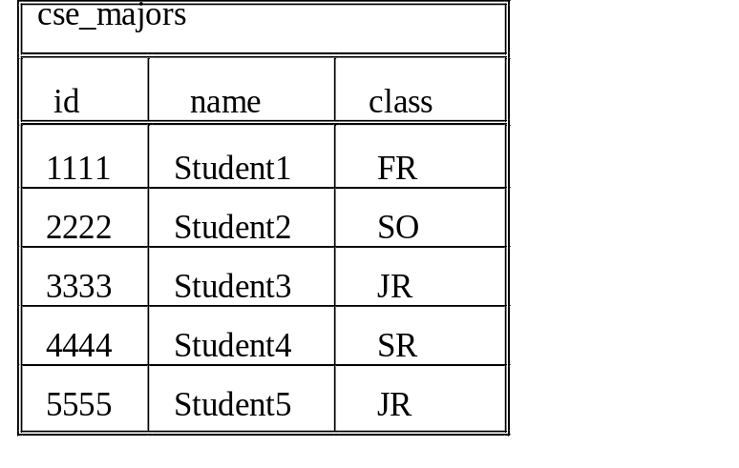
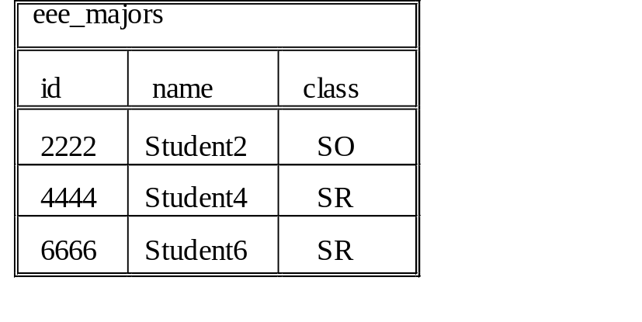
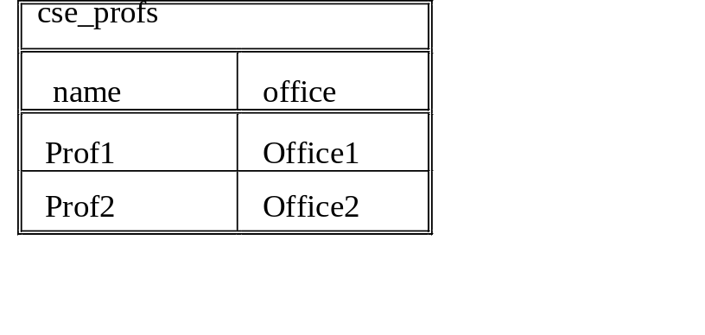
UNIVERSITY EXAMPLE
Schema & Instance

Slide 22
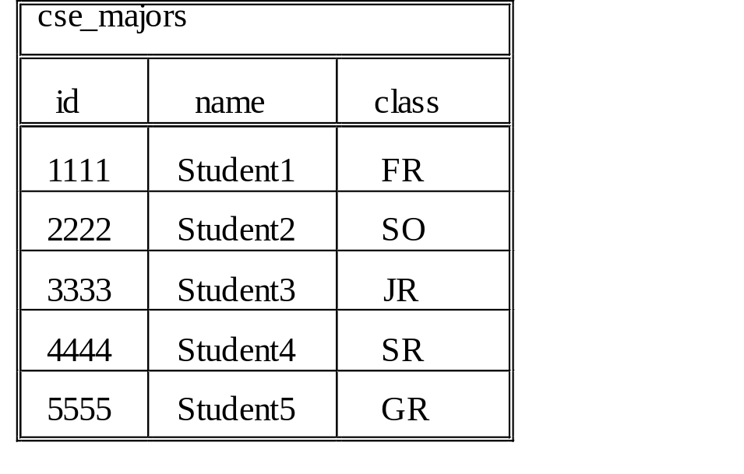
Selection
Selects tuples from relations that satisfy predicate P
Query: List the student information for seniors who are majoring in computer science
SQL:
select *
from cse_majors
where class = 'SR'

Slide 23
Pattern Match in Selection
s LIKE p: pattern matching on strings
p may contain two special symbols:
  % = any sequence of characters
  _ = any single character
Query: Find all courses whose names mention ‘database’:
SQL:
select *
from cse_ courses
where crstitle LIKE ‘%Database%’

Slide 24
Projection
Projects attributes given by the set A from relation R where A is a subset of the attributes of R (i.e. A ⊆ R).
Query:
List the name and id of students who are computer science majors.
SQL
select id, name
from cse_majors

Slide 25
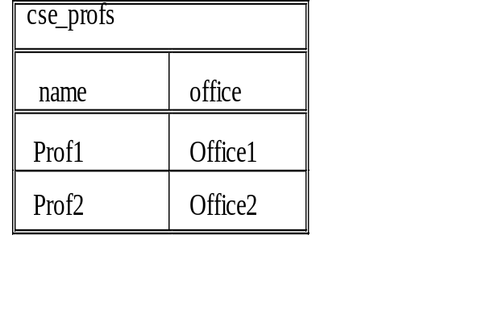

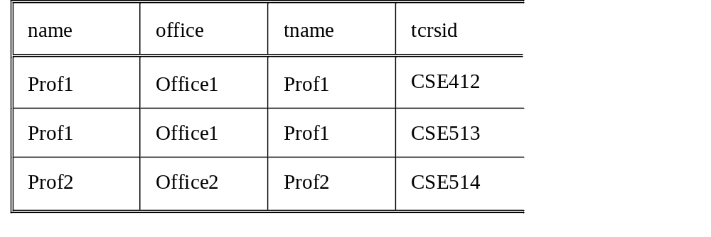
Joins
Connect two or more tables R1, .. Rn based on P
Query: List the names of the instructors of each CSE course
SQL:
select *
from cse_profs P, teaches T
where P.name = T.tname
alias (or tuple variable). Equivalently, “cse_profs as P”
If an attribute name only appears in one relation, then it can be referred without relation name.

Slide 26
Set Operations
Union: select * from cse_majors
union
select * from eee_majors
difference: select * from cse_majors
except
select * from eee_majors
Intersection: select * from cse_majors
intersect
select * from eee_majors

Slide 27
MultiSet VS Set Semantics
An SQL relation, resulted from a query evaluation, is not a set of tuples but a multiset (bag) of tuples
i.e. a relation can have two or more tuples that are identical in all their attribute values.
To force the elimination of duplicates, use distinct in the select clause:
select distinct A₁,A₂,...,A_{n} from r
Note that union, except and intersect return a set of tuples. To allow duplicates, use union all, except all and intersec all

Slide 28
Exercise
Given schemas:
cse_major(id, name, class)
cse_profs (name, office)
teaches(tname, tcrsid)
cse_courses(crsid, crstitle)
Q1: find the names of JR students in cse.
Q2: find the office of the professor who teaches ‘database management’.

Slide 29
Outline
Data Definition
  Create/Drop/Alter table
Data Manipulation
  Insert/delete/update tuples
  SQL query basics
  Advanced queries
Integrity Constraints

Slide 30
Complex Queries
SQL supports more complex queries than the basic select-from-where statement.
  Nested subqueries
  Explicit Sets
  Nested correlated subqueries (Exists/Not Exists)
  Order by
  Aggregation
  Group by
  Having
  Division

Slide 31
NESTED SUBQUERIES
Set Comparison
Query: Find computer science majors who are also majoring in electrical engineering.
SQL: select id, name
from cse_majors
where id in
(select id
from eee_majors)
Evaluation:
  nested query
  outer query using results of nested query

Slide 32
NESTED SUBQUERIES
Equality Comparison
Query: Find the name of the professor who is currently teaching the ‘Database Management’ course.
SQL: select tname
from teaches
where tcrsid =
(select crsid
from cse_courses
where crstitle = ‘Database Management’)
Evaluation: To use an equality comparison, the nested query must return a single value.

Slide 33
EXPLICIT SETS
Example
Query: Find upper-level computer science majors
SQL: select id
from cse_majors
where class in (‘JR’, ‘SR’);

Slide 34
NESTED CORRELATED SUBQUERIES
Exists/Not Exists
A nested correlated subquery is a nested query that references a value of the outer subquery.
EXISTS: Evaluates to FALSE if the subquery evaluates to empty; TRUE otherwise.
Query: Find the professors who are not teaching any courses.
SQL: select P.name, P.address
from cse_profs P
where not exists
(select *
from teaches T
where T.tname = P.name)
Evaluation:
For each cse_profs tuple, the nested query selects all teaches tuples whose tname value matches the cse_profs name;
If the result of the exists subquery is empty, then that professor is not teaching any classes, so the professor is included in the result.

Slide 35
ORDER BY
SQL provides an order by clause to display the query result in sorted order:
select A₁,...,A_{n} from r where P order by ORDER-SPEC-COMMALIST
ORDER-SPEC-COMMALIST ::= { COLUMN-REF | INTEGER } [asc|desc]
where
  COLUMN-REF is an attribute name, and
  INTEGER is a column position
  asc means ascending (default order if none specified)
  desc means descending
Query: Find the courses taught by each professor. Display the results in alphabetical order by the name of the professor, with courses displayed in descending order by professor.
SQL: select T.tname, T.tcrsid
from teaches T
order by T.tname asc, T.tcrsid desc

Slide 36
AGGREGATION
To aggregate over the entire table (with column renaming):
select aggregate_operator(Ai) [as nameOfAttribute]
from r
[where P]
Built-in aggregate operators: COUNT, SUM, MAX, MIN, AVG
e.g. Find the number of courses that are currently being taught.
select count(*) as numberOfCourses
from teaches T
The name of the attribute representing the aggregation is implementation–dependent. Therefore, it is highly recommended to use the column renaming feature in SQL to provide a name for the aggregation.
COUNT applies to duplicates, unless otherwise stated.

Slide 37
Aggregation Example
"Find the employee(s) with the maximum salary“
emp(ID, NAME, SAL, SUPERID, DNO)
select id, name, salary
from emp
where salary = ( select max(salary)
from emp )
Note that WinRDBI does not allow aggregation in a nested query. Use multiple steps:
empMaxSal(maxSalary) := select max(salary) from emp;
select id, name, salary
from emp
where salary = (select maxSalary from empMaxSal);

Slide 38
GROUPING
To aggregate over a group of attributes:
select A_{i}, ..., A_{j}, aggregate_operator(A_{n}) [as nameOfAttribute ]
from r
[where P]
group by A_{i},...,A_{j}
e.g. Find the number of computer science courses that each computer science professor is currently teaching:
select tname, count(*) as numberCoursesForCSEProf
from teaches T
group by tname;
SQL groups the tuples together based on the values of the group by attributes and performs the aggregation over the group.
The attributes in the select clause and the group by attributes must agree so that the aggregation can return one value for each group.

Slide 39
HAVING CLAUSE
Can only appear in conjunction with a GROUP BY
Specifies a condition on the grouping attributes. Only groups that satisfy the having condition are included in the answer
Query: For each professor teaching more than one course, display the name of the professor and the number of courses the professor is teaching.
SQL: select T.tname, count(*) as numberOfCoursesForProf
from teaches T
group by T.tname
having count(*) > 1
Evaluation:
  where - condition on individual tuples
  group by - groups by grouping attributes
  having - conditions on the group selected

Slide 40
General form of Grouping and Aggregation
SELECT S
FROM R₁,…,R_{n}
WHERE C1
GROUP BY a₁,…,a_{k}
HAVING C2
S = may contain attributes a₁,…,a_{k} and/or any aggregates but NO OTHER ATTRIBUTES
C1 = is any condition on the attributes in R₁,…,R_{n}
C2 = is any condition on aggregate expressions
Why ?

Slide 41
EXERCISE
emp(id, name, sal, dnum) dept(dnum, dname, mgrid)
takes(id, crsid, date) course(crsid, cname, inst, len)
List the names of the employees who took the course DB1 on
June 25, 1990.
Who is the manager of the employee 'John Smith'?
Output the name and department of the manager.
Find the average salaries of employees by department.
Output the department number (DNUM) and average salary.

Slide 42
EXERCISE ANSWER
emp(id, name, sal, dnum) dept(dnum, dname, mgrid)
takes(id, crsid, date) course(crsid, cname, inst, len)
List the names of the employees who took the course DB1 on June 25, 1990.
select name
from emp, takes, course
where emp.id=takes.id and takes.crsid=course.crsid and date=‘06/25/1990’ and cname=‘DB1’
Who is the manager of the employee 'John Smith'?
Output the name and department of the manager.
select E2.name, dname
from emp E1, dept, emp E2
where E1.name = `John Smith’ and E1.dnum=dept.dnum and dept.mgrid=E2.id
Find the average salaries of employees by department.
Output the department number (DNUM) and average salary.
select dnum, avg(sal) as avgSalary
from emp
group by dnum

Slide 43
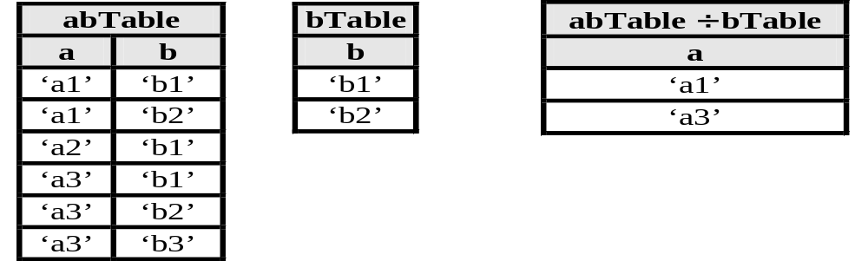
Division Example
Given abTable ¸ bTable, which a’s are related to all b’s in the bTable?
SQL select distinct T.a
from abTable T
where not exists
(select *
from bTable B
where not exists
(select *
from abTable AB
where AB.a=T.a and AB.b=B.b));
i.e. find all a_{i} (a_{i} in abTable) that does not have b_{j} (b_{j} in bTable), which does not have (a_{i} , b_{j}) is in abTable
Notes:
Find all the tuples x in abTable, s.t. there does not exist a tuple in bTable, which in turn can not be joined with x.
This is equivalent as: find all tuples x in abTable that can be joined with every tuple in bTable

Slide 44
Division Example - Counting
Count the number of b’s in the bTable
create view countBs as
select count(distinct b) as numberOfBs
from bTable;
Count the number of b’s in the bTable that are related to each a
create view countAB as
select AB.a, count(distinct AB.b) as relatedBs
from abTable AB
where AB.b in (select b from bTable)
group by AB.a;
Select the a’s that are related to all of the b’s in the bTable
select AB.a
from countAB AB, countBs B
where AB.relatedBs = B.numberOfBs;

Slide 45
Division Example - Contains
CONTAINS is provided in some dialects of SQL, but it is not part of the SQL standard.
  This is NOT a valid solution for assignments or exams
select distinct T.a
from abTable T
where
(select AB.b
from abTable AB
where AB.a = T.a)
contains
(select b from bTable)

Slide 46
Division Example - Explicit Values
Using explicit values with intersection is NOT a general solution to the division problem in SQL, but provides a brute force approach.
  This is NOT a valid solution for assignments or exams
select a
from abTable
where b = ‘b1’
intersect
select a
from abTable
where b = ‘b2’

Slide 47
Outline
Data Definition
  Create/Drop/Alter table
Data Manipulation
  Insert/delete/update tuples
  SQL query basics
  Advanced queries
More on Data Definition: Integrity Constraints and Indexes

Slide 48
Create Views and Snapshots
create view VIEW-NAME as S-F-W
  A view is a relation that is not explicitly stored in the database. It is made visible to a user as a "virtual relation".
  For presenting different information to different users
  A view is recomputed for each query that refers to the VIEW-NAME.
  e.g. create view cse_seniors as
select * from cse_majors where class = ‘SR’
create snapshot VIEW-NAME as S-F-W
  A snapshot is a materialized view, which is materialized once at the time the "create snapshot" command is issued.
  The queries in the query pane of WinRDBI are materialized views or snapshots.
  Updating a materialized view is an active research problem.

Slide 49
INTEGRITY CONSTRAINTS
Declarative specification of constraints used to maintain the integrity/consistency of the data in the database
STATIC CONSTRAINTS (current state of the database)
  domain constraint: possible values of an attribute
  uniqueness constraint: no two entity instances of the entity type have the same value for the attributes that are unique
  attribute structural constraint: not null specification
  relationship structural constraint: participation constraints in the relationship; referential integrity constraints
DYNAMIC CONSTRAINTS (on transition between states)
usually specified explicitly using a constraint specification language
Notes:
for a 1-n relationship over entity A and B.
To express participation constraints of B:
In table for B: T_B which contains attributes of B and the Akey. specify that Akey can not be null. i.e. every B entity is involved in a relationship
To express participation constraints of A:
In table for A: T_A, specify Akey is a FK of T_B.Akey
Note that it’s always the case that T_B.Akey is a FK of T_A.Akey
n-m relationship can be handled similarly

Slide 50
INHERENT/IMPLICIT CONSTRAINTS
With Respect To Data Model
constraints that exist within the schema definition; either built-in to the data model or specifiable in DDL, e.g.,
uniqueness constraints (unique) and attribute specification constraints (not null) tend to be implicit in high-level data models;
some implicit constraints (referential integrity) are shortcuts for constraints that can be represented explicitly
e.g. : foreign key (tcrsid) references cse_courses(crsid)
versus
create assertion ref_int_on_crsid
check (not exists ( select *
from teaches T
where not exists
( select *
from cse_courses C
where T.tcrsid=C.crsid)))

Slide 51
EXPLICIT CONSTRAINTS
Declarative vs. Procedural
Declarative specification
  constraint specification language
  integrity control subsystem enforces constraint on the db
  create assertion <name> check(<condition>)
  e.g. create assertion salary_range
  check (not exists (select * from employee
  where salary < 3K or salary > 200K))
Procedural specification:
  Responsibility of database programmer to enforce constraints
  Specified procedurally using an imperative programming language
  e.g. every transaction that inserts or updates an employee's salary must check this constraint procedurally (triggers)
  if (salary < 3K) or (salary > 200K)
  then …

Slide 52
INDEXES
Really important to speed up query processing.
Suppose we have a relation
person (id, name, age, city)
Sequential scan of the relation may take long time.
Solution: create indexes
SELECT *
FROM person
WHERE name = “Smith”

Slide 53
CREATING INDEXES (I)
Create an index on name:
B+ trees have fan-out of 100s: max 4 levels !
CREATE INDEX nameIndex ON Person(name)
Adam | Betty | Charles | …. | Smith | ….

Slide 54
CREATING INDEXES (II)
B+ Indexes can be useful in range queries too:
However, B+ indexes are not helpful for queries like
This is why RDBMS requires atomic values
CREATE INDEX ageIndex ON person (age)
SELECT *
FROM person
WHERE age > 21 AND age < 30
SELECT *
FROM person
WHERE name LIKE `%mi%’

Slide 55
CREATING INDEXES (III)
Indexes can be created on more than one attribute:
CREATE INDEX doubleindex ON
Person (age, city)
Example:
SELECT *
FROM Person
WHERE age = 25 AND city = “Tempe”
Helps in:
SELECT *
FROM Person
WHERE age = 25
and even in:
SELECT *
FROM Person
WHERE city = “Tempe”
But not in:

Slide 56
MORE on INDEXES
What indexes should we build to speed up the workload ? Why not create indexes on everything?
We are given a workload = a set of SQL queries plus how often they run
FROM/WHERE clauses ➔ favor an index
INSERT/UPDATE clauses ➔ discourage an index
Index selection = normally done by people. Automating index selection is a research problem.
More questions on index: How does an index work? What indexes to create among a set of different types (B+tree, hash, inverted index, R-tree, bitmap, etc)? On which attributes an index needs to be built?
--- take an advanced DB course (CSE 414)

Slide 57
SQL DATABASE ACCESS
FROM A PROGRAMMING LANGUAGE
SQL is a query language – not a general purpose programming language.
SQL can be
  embedded in a programming language
  e.g., SQLJ specification for embedding SQL statements Java programs
or
  called from within a programming language using a call-level interface
  e.g., JDBC API for dynamic access from Java

Slide 58
In almost all DB applications, we need to call SQL from a PL, including the course project
The blackboard, we have tutorials on
  Using SQL in Java
  Developing DB web application using ASP.net

Slide 59
Using SQL in Java
- Connecting to DB
  StringdriverName="com.microsoft.sqlserver.jdbc.SQLServerDriver
  String dbURL="jdbc:sqlserver://localhost:1433;DatabaseName=sample";
  String userName="sa";
  String userPwd="123456";
  Connection dbConn=null;
  try
  {
  Class.forName(driverName);
  dbConn=DriverManager.getConnection(dbURL,userName,userPwd);
  System.out.println("Connection Successful!");
  }
  catch(Exception e)
  { e.printStackTrace(); }

Slide 60
Using SQL in Java
- Execute SQL Stmt
This can be any valid SQL stmt.
String q = "SELECT * FROM person";
String temp=null;
try
{
Statement stat =
dbConn.createStatement();
stat.execute(q);
ResultSet rs = stat.getResultSet();
while (rs.next())
{
temp = rs.getString(“name");
System.out.print(temp+"\n");
}
}
All the tuples returned are stored in the ResultSet rs
Imagine it is a Vector of tuple in Java, we use similar method as Iterator
Use:
.getString(int columnIndex)
or
.getString(String columnName)
to read the value of specific column

Slide 61
Using SQL in Java
- Closing the connection and handling exception
try
{
…. // Querying and updating DB
dbConn.close();
}
catch(SQLException e)
{
e.printStackTrace();
}

